Slide 1
ERP Cloud Migration ——Protera Case Study
Team 4: Matthew Dionisio, Seven Zhou, Zhen Li
Professor: Dr. G. Tony Bell
December 6, 2021

Slide 2
Business Situation
60%
or more companies still use outdated ERP systems, per Microsoft survey.
59%
of respondents expressed they will prefer an upgrade to cloud-based ERP in their next implementation, per the Microsoft survey.
80%
of organizations are allocating budget for cloud projects. However, more than half are burdened with legacy systems and lack in-house expertise, per IBM.
https://xcelpros.com/migration-from-on-premise-to-cloud-based-erp-system/

Slide 3
Why Cloud?
On-premise ERP
Series of hardware updates
Security concerns
Regulatory compliance
Policy necessities
Cloud ERP
Improved ERP performance
Reduced operational costs
Higher security
Real-Time Analytics
Enhanced UAT and API testing
https://xcelpros.com/migration-from-on-premise-to-cloud-based-erp-system/

Slide 4

Current Challenges
Foregone Proof of Concept Cloud Migration
Strategic Gaps in Your Target Approach to ERP Migration
Data Inconsistency and Mismatching
Lack of Strategic Alignment Within the Organization
Failure to Address the Security Issues
https://www.infopulse.com/blog/top-reasons-erp-system-cloud-migration-fails/

Slide 5
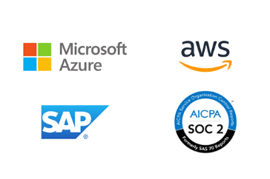
Protera Technologies Background
Protera Technologies, LLC., a global business critical managed enterprise cloud and hosting services provider, was formed in the mid-90s to provide comprehensive end-to-end IT solutions for its customers.
1st SAP-certified partner to run SAP on cloud
Partnerships:
Only Microsoft Azure Preferred Partner for SAP migrations
Amazon AWS Migration Acceleration Partner
Services:
Move to cloud
Move to S/4 HANA
Manage/consult a current S/4 HANA enterprise
https://www.protera.com/about/

Slide 6
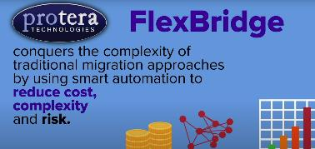
Flexbridge
What is it?
Protera’s HANA and S/4 HANA Migration services tool
Uses machine learning to continuously improve migration
Automatically identifies and corrects errors
Project management console for visualizing the time and cost of the migration
Flexbridge provides tools and automations that guarantee SAP-recommended best practices at each phase of the migration project regardless of the complexity of the pre and post migration environment.
Advantages
45% project timeframe reduction, 50% data quality increase, and over 50% cost reduction (on average)
https://www.protera.com/sap/news/protera-technologies-is-offering-free-proof-of-concept-flexbridge-migrations-to-help-organizations-streamline-their-journey-to-sap-hana-s4-hana/

Slide 7
Protera Case Study
Protera was hired by Greenskies (a US top 5 commercial Solar developer) to migrate their cloud and S/4HANA
Greenskies has an integrated business model of sales, finance, engineering, procurement, and construction
Both the financial and operations data involved are massive and need to be monitored in real-time.
SWOT Analysis:
Situation: IT system initially consisted of using excel and other disconnected systems.
Weakness: Legacy construction software in use at the time was outdated.
Opportunity: SAP was evolving at the same time that Greenskies was looking to
Threat: Industry is very cyclical and Greenskies needed something to help further distinguish them from the pack.
https://www.protera.com/sap-support/cio-series-greenskies

Slide 8
Protera Case Study (cont’d)
Results:
Now has full custom data warehouse and application set built in-house running on S/4 HANA and AWS.
Since this completion in 2015, the growth of their business has increased their operations portfolio 600% while only requiring the workforce to be doubled.
The cloud migration resulted in a cost reduction of 15% shown by resources that, while fully utilized before migration, were redundant upon migration completion to the cloud.

Slide 9
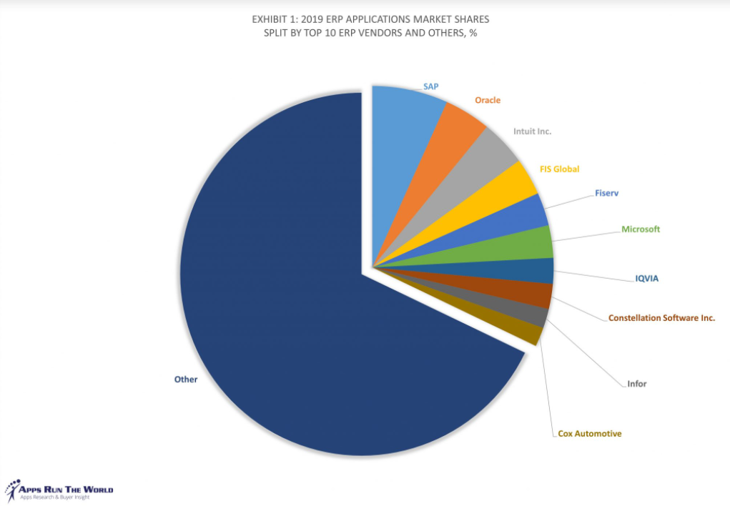
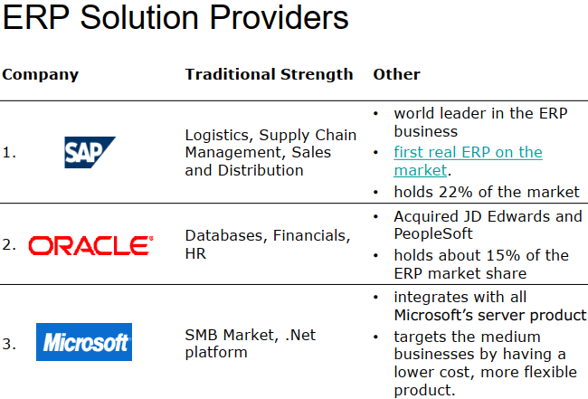
Alternatives & Recommendations
Alternatives: ERP migrations
By only focusing on SAP, Protera is closing itself off from a significant amount of opportunities. There has been a shift in ER market share.
Before
www.businessnsoftware.com/erp-market-share/
https://www.appsruntheworld.com/top-10-erp-software-vendors-and-market-forecast/
http://www.businessnsoftware.com/erp-market-share/

Slide 10
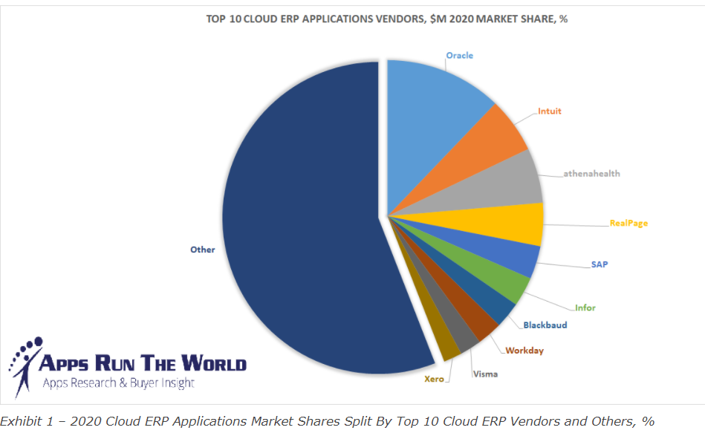
Alternatives & Recommendations
Global ERP software market share by company 2021
As of October 2021, Deltek dominates the global enterprise resource planning (ERP) software market with a share of over 32 percent and 52,334 domains. Microsoft Dynamics came in second in the ERP software market, while Workday came in third at that time.
https://www.statista.com/statistics/249637/erp-software-market-share-by-company/

Slide 11

Adjacent Technologies
IoT AKA “smart things”
Wireless shop floor
Increased percentage of data in real time
Automation
Reduce human error
Reduce risk subject to labor shortage
5G
Quantifiable
“Theoretical latency of less than one millisecond opposed to Wifi latency 20-40 milliseconds”
Results
Safety incident reductions
Efficiency increases
https://www.123rf.com/photo_105499462_3d-rendering-automatic-forklift-with-warehouse-robot-and-drone-in-factory.html
https://technologyadvice.com/blog/information-technology/5g-iot-erp/

Slide 12
Thank you!

Slide 13
References
www.businessnsoftware.com/erp-market-share/
https://www.appsruntheworld.com/top-10-erp-software-vendors-and-market-forecast/
https://www.statista.com/statistics/249637/erp-software-market-share-by-company/
https://www.123rf.com/photo_105499462_3d-rendering-automatic-forklift-with-warehouse-robot-and-drone-in-factory.html
https://technologyadvice.com/blog/information-technology/5g-iot-erp/
https://www.protera.com/about/
https://www.protera.com/sap/news/protera-technologies-is-offering-free-proof-of-concept-flexbridge-migrations-to-help-organizations-streamline-their-journey-to-sap-hana-s4-hana/
https://www.protera.com/sap-support/cio-series-greenskies

